Slide 1

School of Computing Science & Engineering
Course Code: BCS01T1001 Course Name: Data Analytics
Data Analytics
Faculty Name: Dr. Varun Tiwari Program Name: B.Tech

Slide 2
Data
Data?
In computing, Data is information that has been translated into a form that is efficient for movement or processing. Data can exist in a variety of forms as numbers or text on pieces of paper, as bits and bytes stored in electronic memory, or as facts stored in a person's mind.

Slide 3
Analytics
Analytics
Analytics is the discovery, interpretation, and communication of meaningful patterns in data and applying those patterns towards effective decision making .Analytics is an encompassing and multidimensional field that uses mathematics, statistics, predictive modelling and machine learning techniques to find meaningful patterns and knowledge in recorded data.

Slide 4
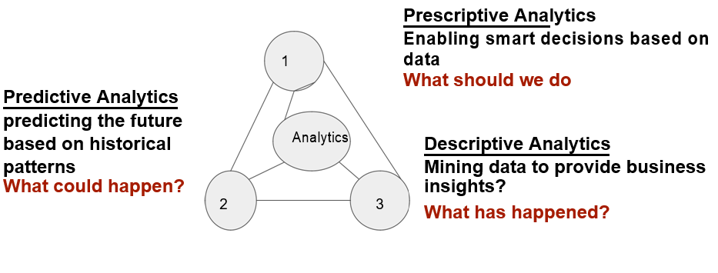
Analytics

Slide 5

Types of Analytics
Types of Analytics

Slide 6
Data Analytics
What is DATA analytics
Data analysis is a process of inspecting, cleansing, transforming, and modeling data. Data analytics refers to qualitative and quantitative techniques and processes used to enhance productivity and business gain.

Slide 7
Introduction to Spread Sheets
What is Spreadsheet?
An arrangement of cells in columns and rows used to organize, analyze, calculate, and report information, usually in numerical form.

Slide 8
Introduction to Spread Sheets
What is Workbook?
A file which contains one or more spreadsheets.

Slide 9
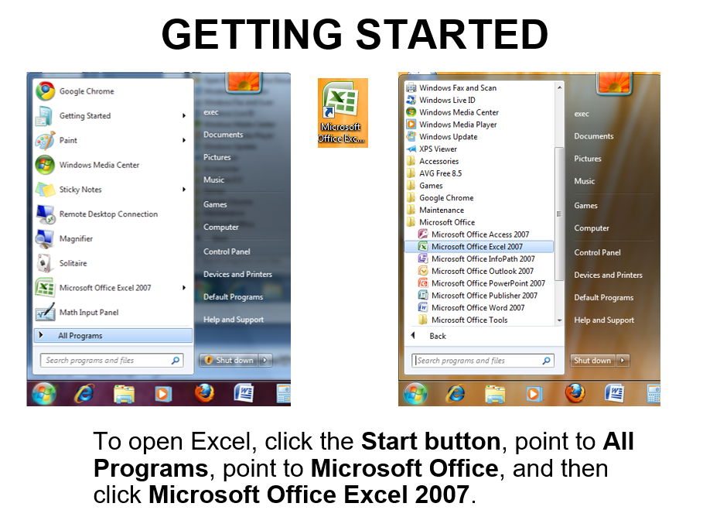
Excel Getting Started

Slide 10
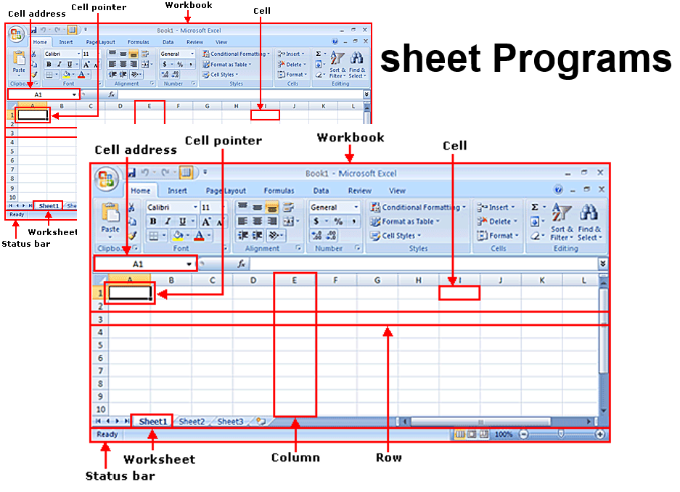
Spread Sheet

Slide 11
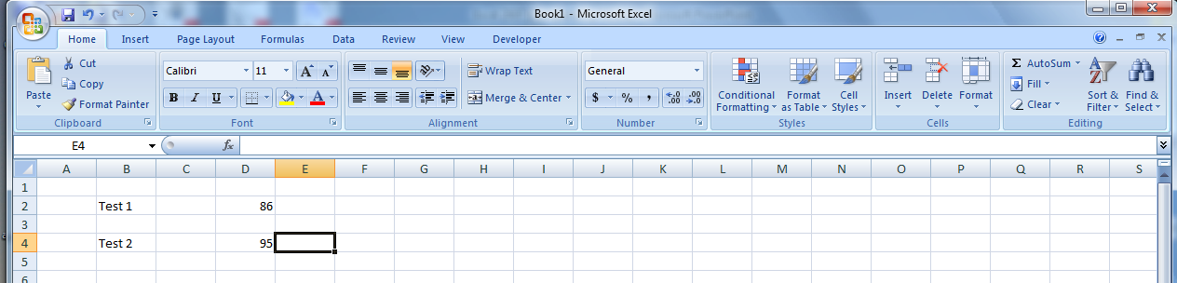
Working in a Spread sheet
To work with a spreadsheet, you enter data in the cells of the spreadsheet.
You enter data by clicking a cell and typing the data.
To replace data in a cell, you click the specific cell and type the new data.
To edit data in a cell, you double click in the cell and type additional data.
Note: when editing data, a blinking cursor appears.

Slide 12
Working in a spreadsheet (cont.)
You can enter three types of data in a spreadsheet:
Text: Text data has no numeric value associated with it.
Numbers: A number has a constant numeric value, such as the test scores attained by a student.
Formulas and functions: Formulas and functions are mathematical equations.

Slide 13
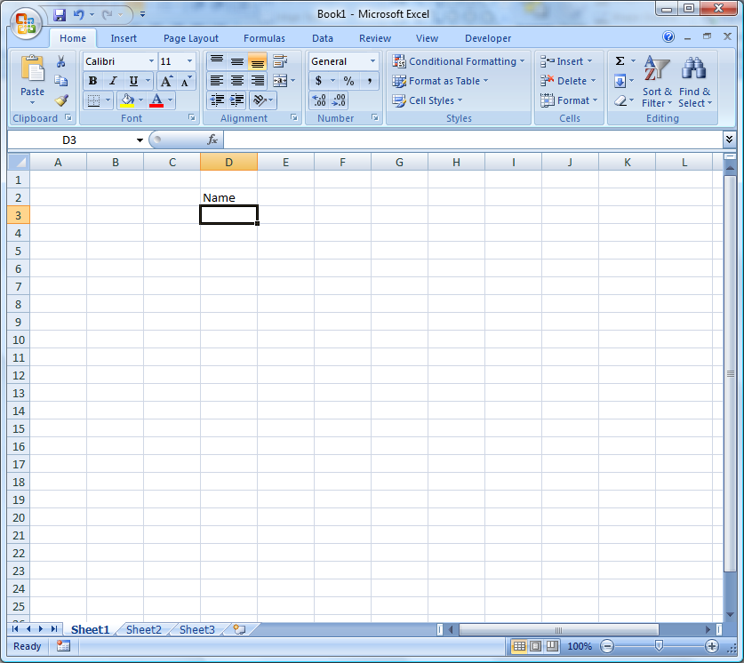
Working in a spreadsheet (cont.)
To ENTER data:
click on the cell
type information
press ENTER.
The data can be both number and text.

Slide 14
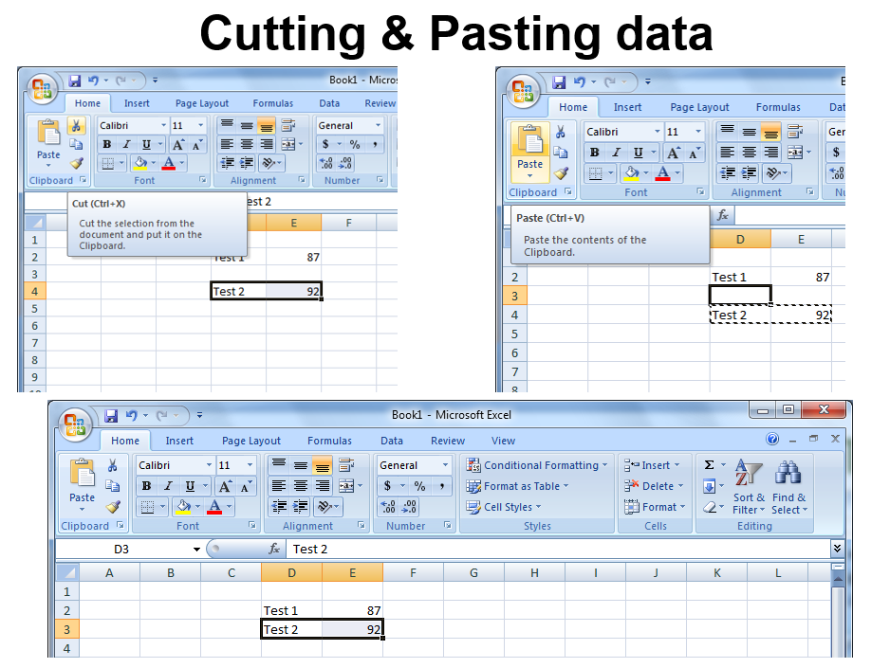
Working in a spreadsheet (cont.)

Slide 15
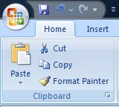
Cutting & Pasting data (cont.)
To COPY contents of a cell:
Click on the cell,
Select the Home tab,
Click Copy from the Clipboard Group.
To PASTE contents of a cell:
click on the cell,
Select the Home tab,
click Paste from the Clipboard Group.

Slide 16
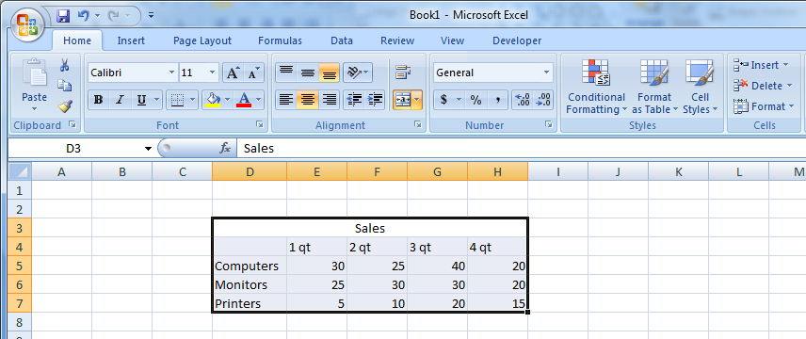
Selecting cells
To select a range of cells in a column/row, click the left mouse button in a cell & drag the mouse pointer to highlight the cells of your choice.

Slide 17
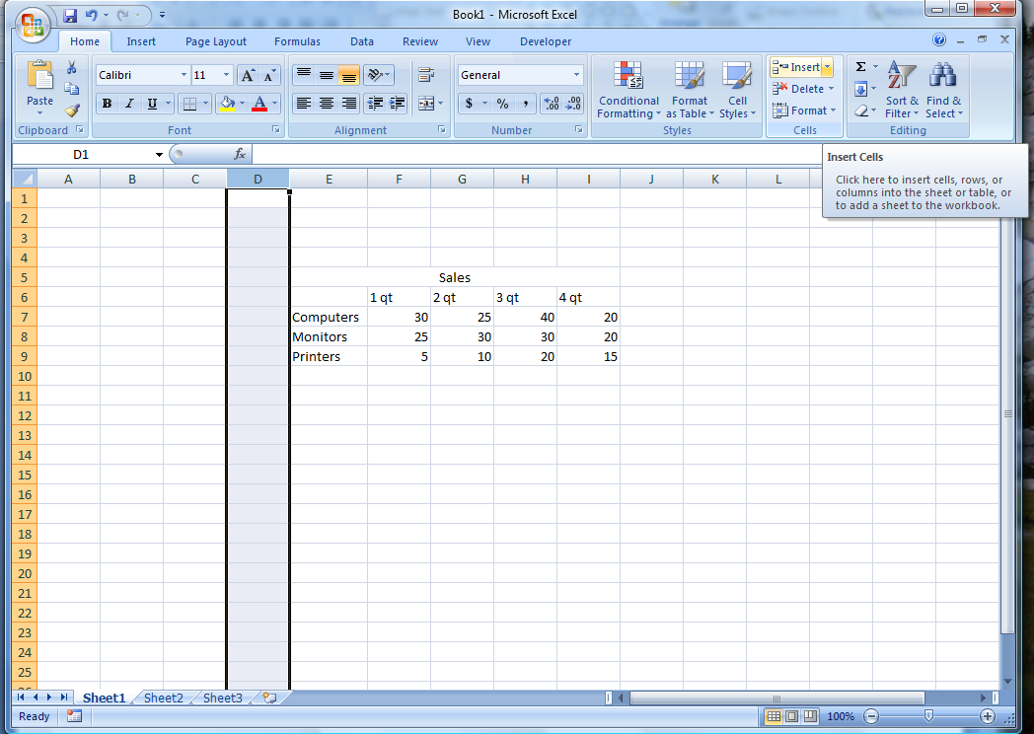
Adding rows & columns
To INSERT a Row/Column:
Select the row/column heading,
Click the Home Tab,
Click the Insert button from the Cells Group.
The insertion occurs before the selected column/row.

Slide 18
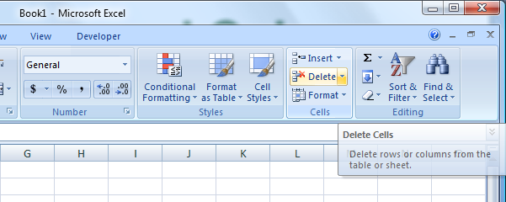
Deleting Rows and Columns
To delete a column/row:
click the column/row heading
click the Delete button on the Cells Group of the Home Ribbon.

Slide 19
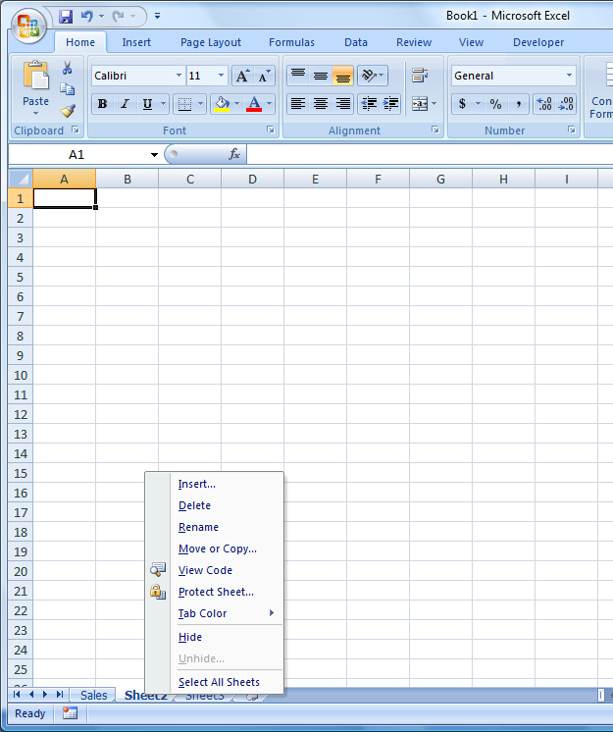
Editing spreadsheets
To rename a worksheet:
double-click the sheet tab
type the new name
press ENTER
You can also Delete & Insert a Worksheet as well.

Slide 20
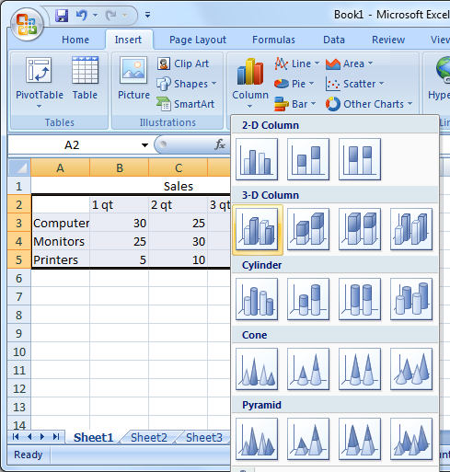
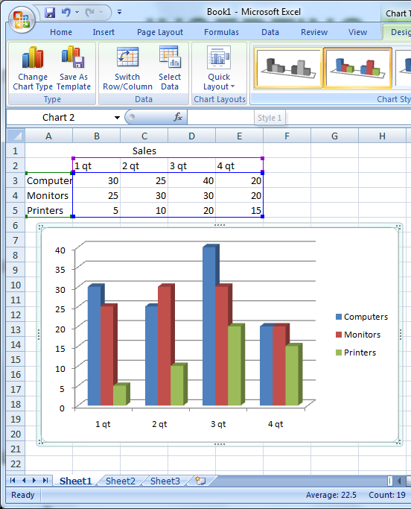
Inserting a chart
Formulas & functions

Slide 21

Formulas & functions
Excel reads any expression that begins with an equal sign as a calculation.
All functions and formulas begin with an equal sign.
The function =SUM(B1:B6)
The formula =B1+B2+B3+B4+B5+B6

Slide 22
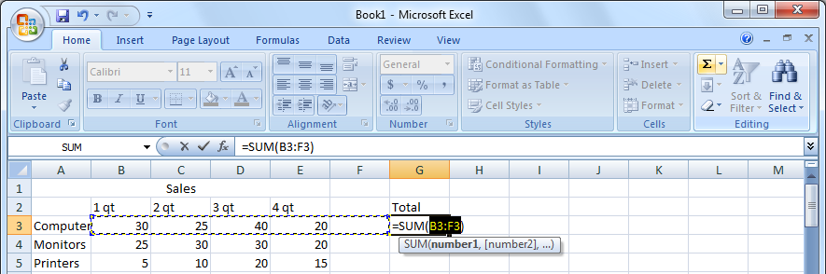
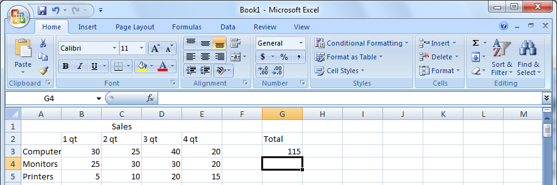
Formulas & Functions
Inserting a function
To Calculate the Sum of cells , click the destination cell, select the SUM button (sigma symbol), select cells for which you want to calculate the sum, drag the mouse pointer from cell C3 to cell C6, and then press ENTER.

Slide 23
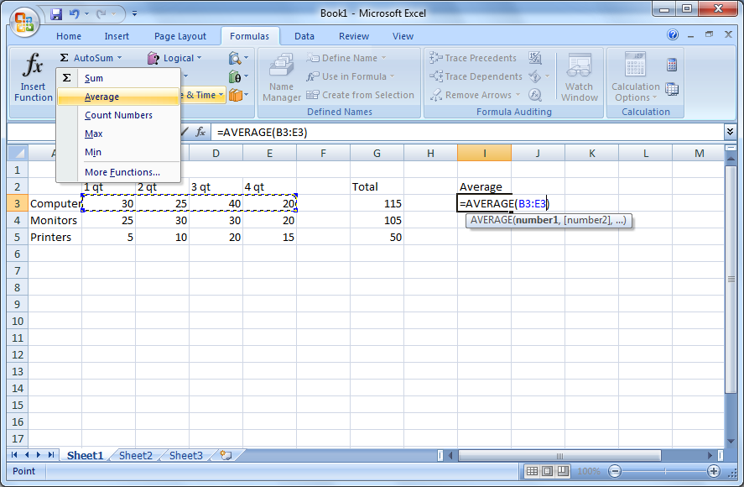
Inserting a function
Inserting a function
Excel also provides a list of predefined formulas called functions. To insert a function to calculate the average of a group of values, click the Insert menu, and then click Function (2)To specify which cells should be used to calculate the average, in the Function Arguments dialog box, press SPACEBAR to have the cell range typed for you in the Number1 box, and then click OK. (3.) To save time, you can use the AutoSum button to perform functions such as sum and average

Slide 24
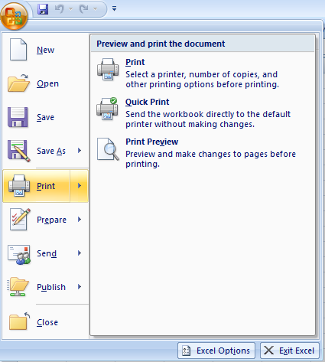
How to Print Spreadsheet Data
To print a spreadsheet, click the Microsoft Office Button, point to Print, and then click Print.
Inserting a function

Slide 25
How to Print Spreadsheet Data
To print a spreadsheet, click the Microsoft Office Button, point to Print, and then click Print.
Inserting a function

Slide 26
Thank You

